Slide 1
MALIGANT COMMENTS CLASSIFICATION

Slide 2
Business Problem
There has been a remarkable increase in the cases of cyberbullying and trolls on various social media platforms. Many celebrities and influences are facing backlashes from people and have to come across hateful and offensive comments. This can take a toll on anyone and affect them mentally leading to depression, mental illness, self-hatred and suicidal thoughts.
Internet comments are bastions of hatred and vitriol. While online anonymity has provided a new outlet for aggression and hate speech, machine learning can be used to fight it. The problem we sought to solve was the tagging of internet comments that are aggressive towards other users. This means that insults to third parties such as celebrities will be tagged as unoffensive, but “u are an idiot” is clearly offensive.
Our goal is to build a prototype of online hate and abuse comment classifier which can used to classify hate and offensive comments so that it can be controlled and restricted from spreading hatred and cyberbullying.

Slide 3
MOTIVATION FOR THE PROJECT
Motivations for malicious comments identified in the study involved targeting people's mistakes. Conversely, most benevolent comments involved encouragement and compliments to help people in difficult or risky situations, showing malicious comments is a primary reason for degradation of online social networks. Moreover, the abolition of anonymity and intensification of punishment in social media can be effective in reducing malicious comments and rumors. However, potential violation of freedom of expression also risks trivializing the online social network itself. Because anonymous forms of freedom of expression have always been controversial in theoretical and normative spheres of social research. Careful consideration of any limiting of comments is necessary before a ban might be contemplated.
Requiring true identities would cause them to be more careful and responsible. Our results also suggest providers of social media services can apply text filters to their systems. Because certain texts are used repeatedly in cyberbullying or malicious comments, providers should be persuaded to develop a system to detect certain texts and alert them as to when to possibly take action against the people posting them. Such a filtering function could reduce the number of all kinds of malicious comments. Conversely, social media service providers should consider posting lists that rank users most active in posting benevolent comments on their sites. Because people generally enjoy self-expression, these rankings could motivate more people to post positive comments as a way to develop a new social norm in which malicious comments are unwelcome and the people posting them are scorned.

Slide 4
Initial understanding of dataset
The Dataset has 1,59,571 rows and 8 columns.
The problem is a Multi-Class Classification Problem.
The Dataset has no null values.
The Dataset has no Duplicates.
The distribution of the Data is imbalanced.

Slide 5
Tools Used

Slide 6
Tools Used
Google Collab
Panda
NumPy
Matplotlib
Seaborn
Sklearn
NLTK

Slide 7
Data Pre-Processing

Slide 8
Data Pre-Processing
Removing Numbers
Removing Emoji
Chat Words Treatment
Lower Casing
Removing Emails
Removing Weblinks
Removing Punctuations
Removing Stop Words
Word Embedding
Bag of Words
TF-iDF
TF-iDF(1-2 Grams)

Slide 9
Visualization

Slide 10
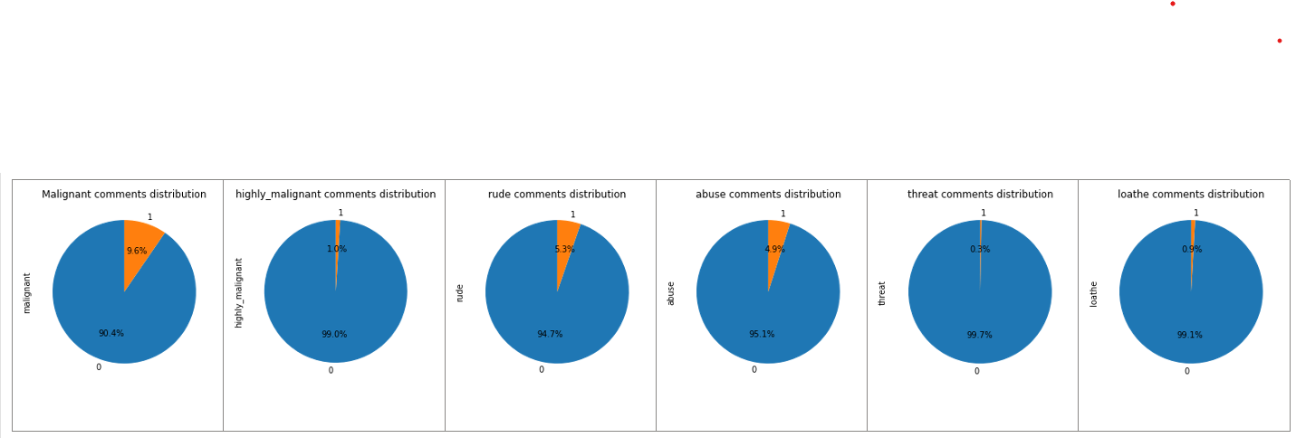
Checking the Distribution of Various Classes

Slide 11
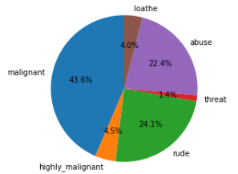
Checking the distribution of the toxic comments

Slide 12
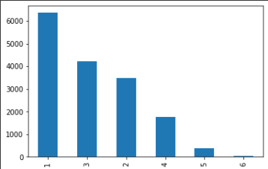
Creating a distribution, the represents the Toxic Comments level by adding the different classes together.

Slide 13
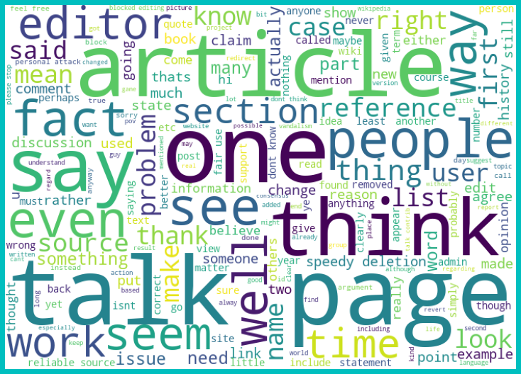
Word Cloud - Non-Toxic Comments

Slide 14
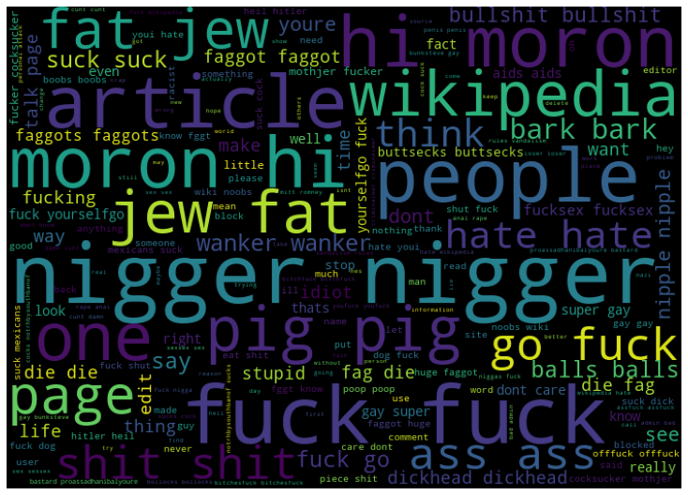
Word Cloud - Malignant Comments

Slide 15
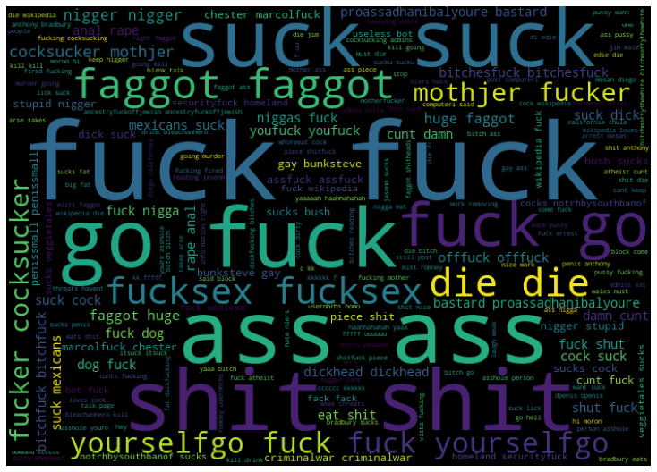
Highly Malignant Comments

Slide 16
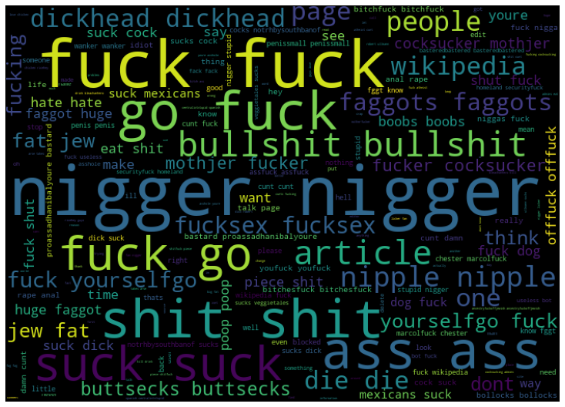
Rude Comments

Slide 17
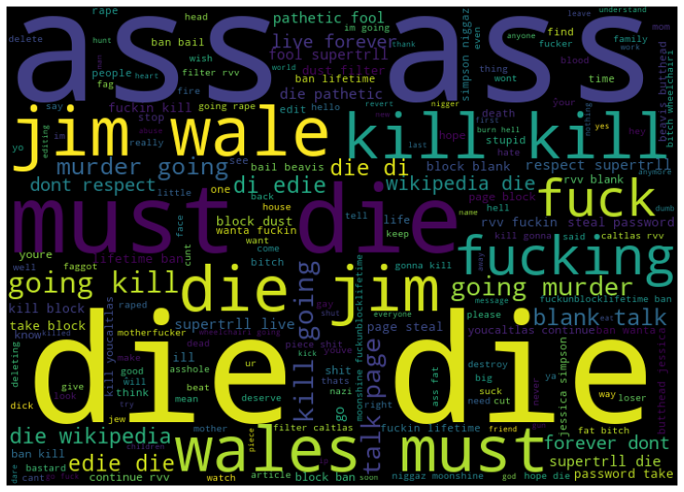
Threatening Comments

Slide 18
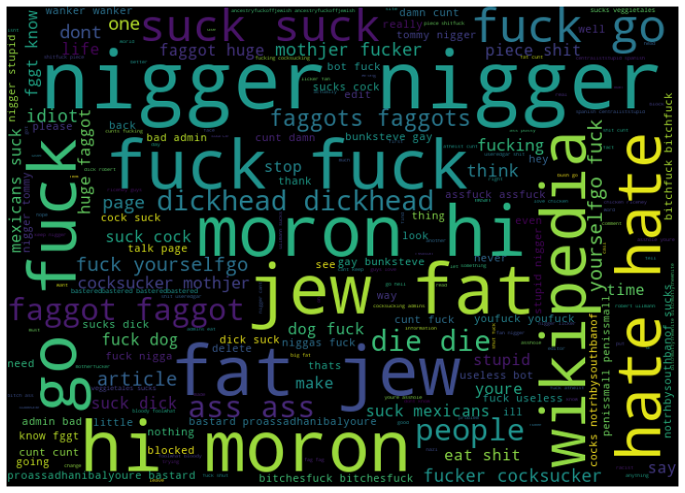
Abusive Comments

Slide 19
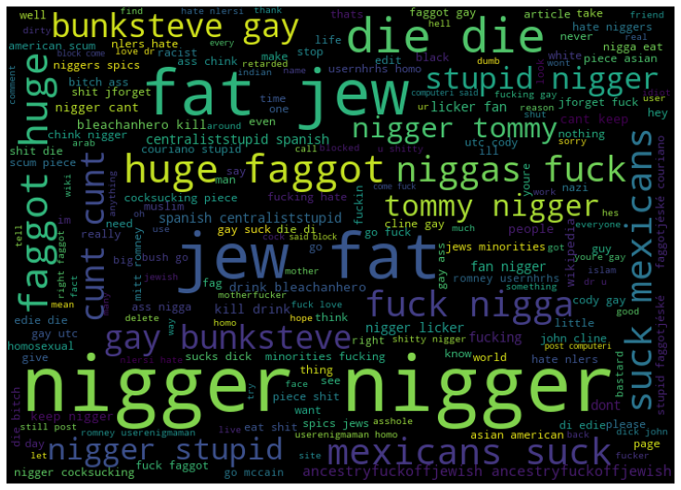
Loathe Comments

Slide 20
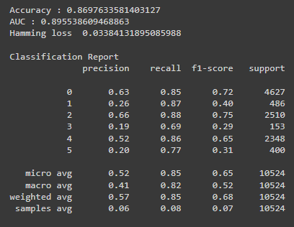
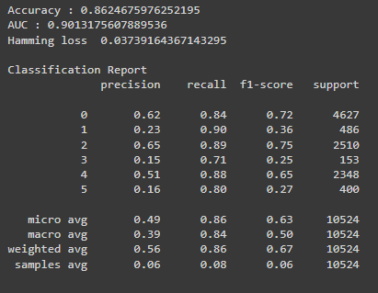
TF-iDF
LogisticRegression
SGDClassifier

Slide 21
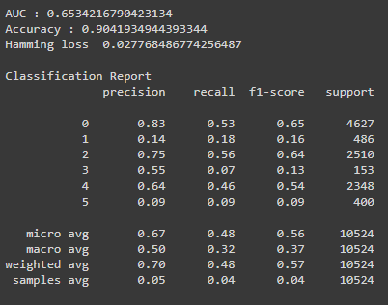
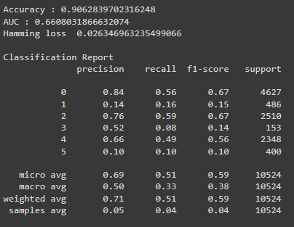
TF-iDF
RandomForestClassifier
ExtraTreesClassifier

Slide 22
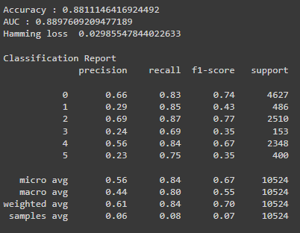
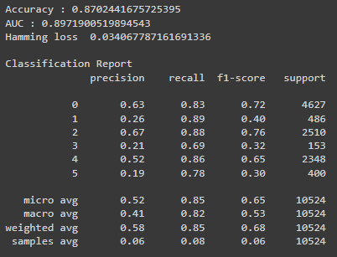
1-2 grams TF-iDF
LogisticRegression
SGDClassifier

Slide 23
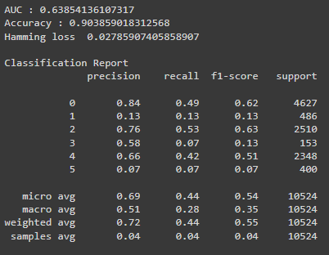
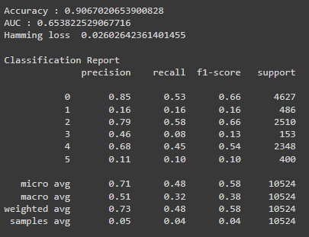
1-2 grams TF-iDF
RandomForestClassifier
ExtraTreesClassifier

Slide 24
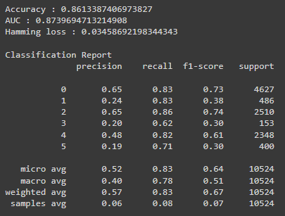
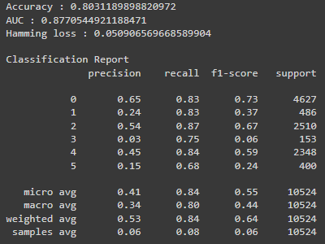
Bag Of Words (BOW)
LogisticRegression
SGDClassifier

Slide 25
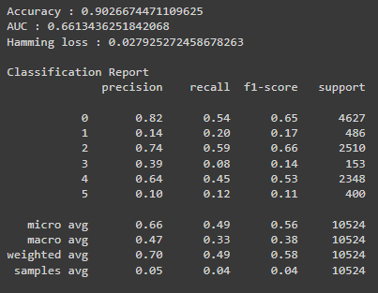
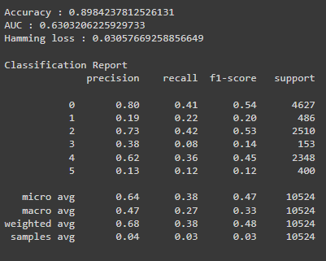
Bag Of Words (BOW)
RandomForestClassifier
ExtraTreesClassifier

Slide 26
Final Model
Based on AUC-ROC Score, Accuracy and Hamming Loss, we choose SGDClassifier with TF-iDF as our Final Model.

Slide 27
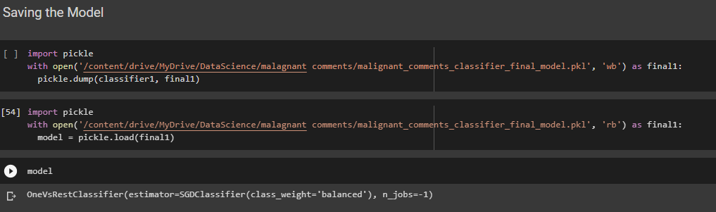
Saving The Model

Slide 28
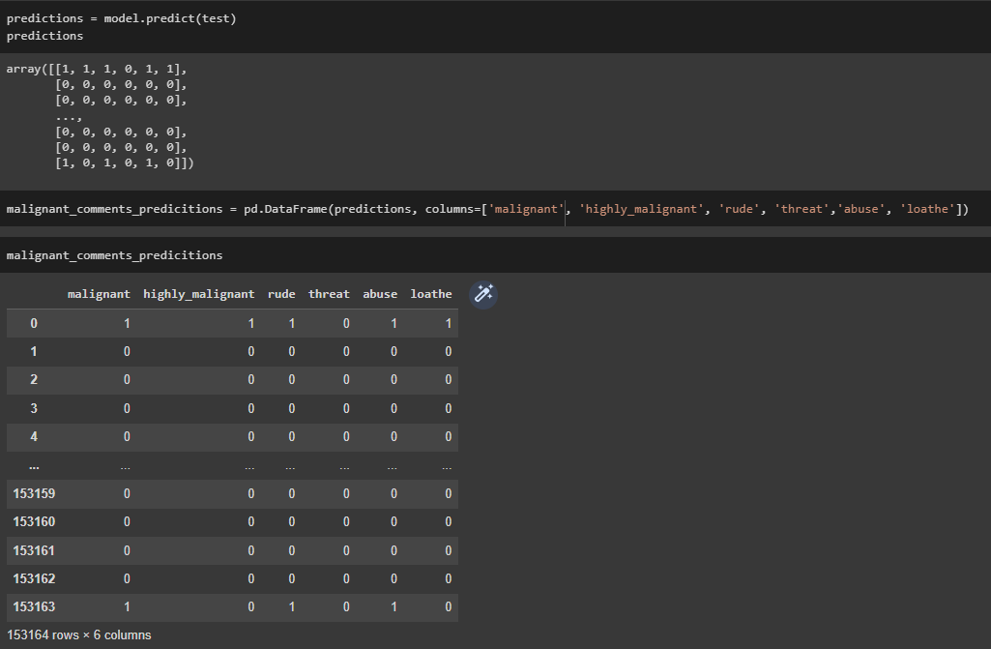
Predictions Of Test Data On Saved Model

Slide 29
Thanks

